Slide 1



Open Source vs Free vs Proprietary Software
The Beauty and Joy of Computing Lecture #8 Recursion I
Jonathan
McKinsey
Open Source SW – “Free” as in no cost
Free SW – “Free” as in Freedom
Proprietary SW – closed source and costs $$
Why Open Source and Free? Linus’ Law - "given enough eyeballs, all bugs are shallow"
www.gnu.org/philosophy/free-software-for-freedom.en.html www.theregister.co.uk/2014/12/27/2014_in_open_source_microsofts_cancer_nasdaq_listings_and_a_quiet_dog

Slide 2
Overview
www.worldofescher.com/gallery/A13.html
Recursion
Demo
Vee example & analysis
Downup
You already know it!
Definition
Trust the Recursion!
Conclusion
M. C. Escher : Drawing Hands

Slide 3
Recursion:
Vee Demo

Slide 4
Recursion:
Downup Demo

Slide 5
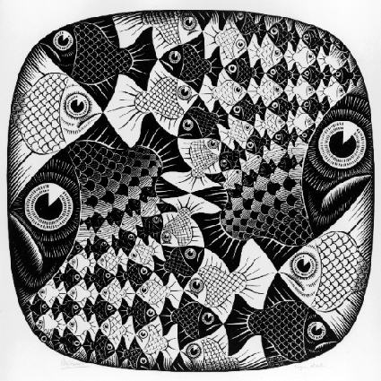
“I Understood Vee & Downup”
Strongly agree
Agree
Neutral
Disagree
Strongly disagree
M. C. Escher : Fish and Scales

Slide 6
Recursion:
Definition, You Know It, Trust It

Slide 7
Definition
www.catb.org/~esr/jargon/html/R/recursion.html www.nist.gov/dads/HTML/recursion.html
Recursion: (noun) See recursion. ☺
An algorithmic technique where a function, in order to accomplish a task, calls itself with some part of the task
Recursive solutions involve two major parts:
Base case(s), the problem is simple enough to be solved directly
Recursive case(s). A recursive case has three components:
Divide the problem into one or more simpler or smaller parts
Invoke the function (recursively) on each part, and
Combine the solutions of the parts into a solution for the problem.
Depending on the problem, any of these may be trivial or complex.

Slide 8
You already know it!

Slide 9
Trust the Recursion
When authoring recursive code:
The base is usually easy: “when to stop?”
In the recursive step
How can we break the problem down into two:
A piece I can handle right now
The answer from a smaller piece of the problem
Assume your self-call does the right thing on a smaller piece of the problem
How to combine parts to get the overall answer?
Practice will make it easier to see idea

Slide 10
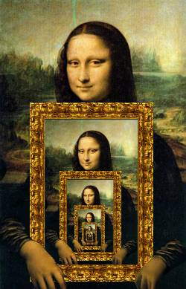
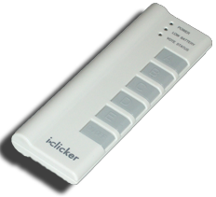
Recursion Versus Iteration
Recursion is  Iteration (i.e. loops)
more powerful than
just as powerful as
more powerful than
just as powerful as
http://www.dominiek.eu/blog/?m=200711

Slide 11
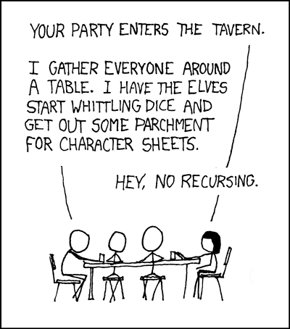
Summary
Behind Abstraction, Recursion is the 2nd biggest idea about programming in this course
Format (usually) is 2 cases:
Base Case
Recursive case
Divide, Invoke, Combine
It’s most useful when the problem is self-similar
It’s no more powerful than iteration, but often leads to more concise & better code
xkcd.com/244/
☑

